Slide 2
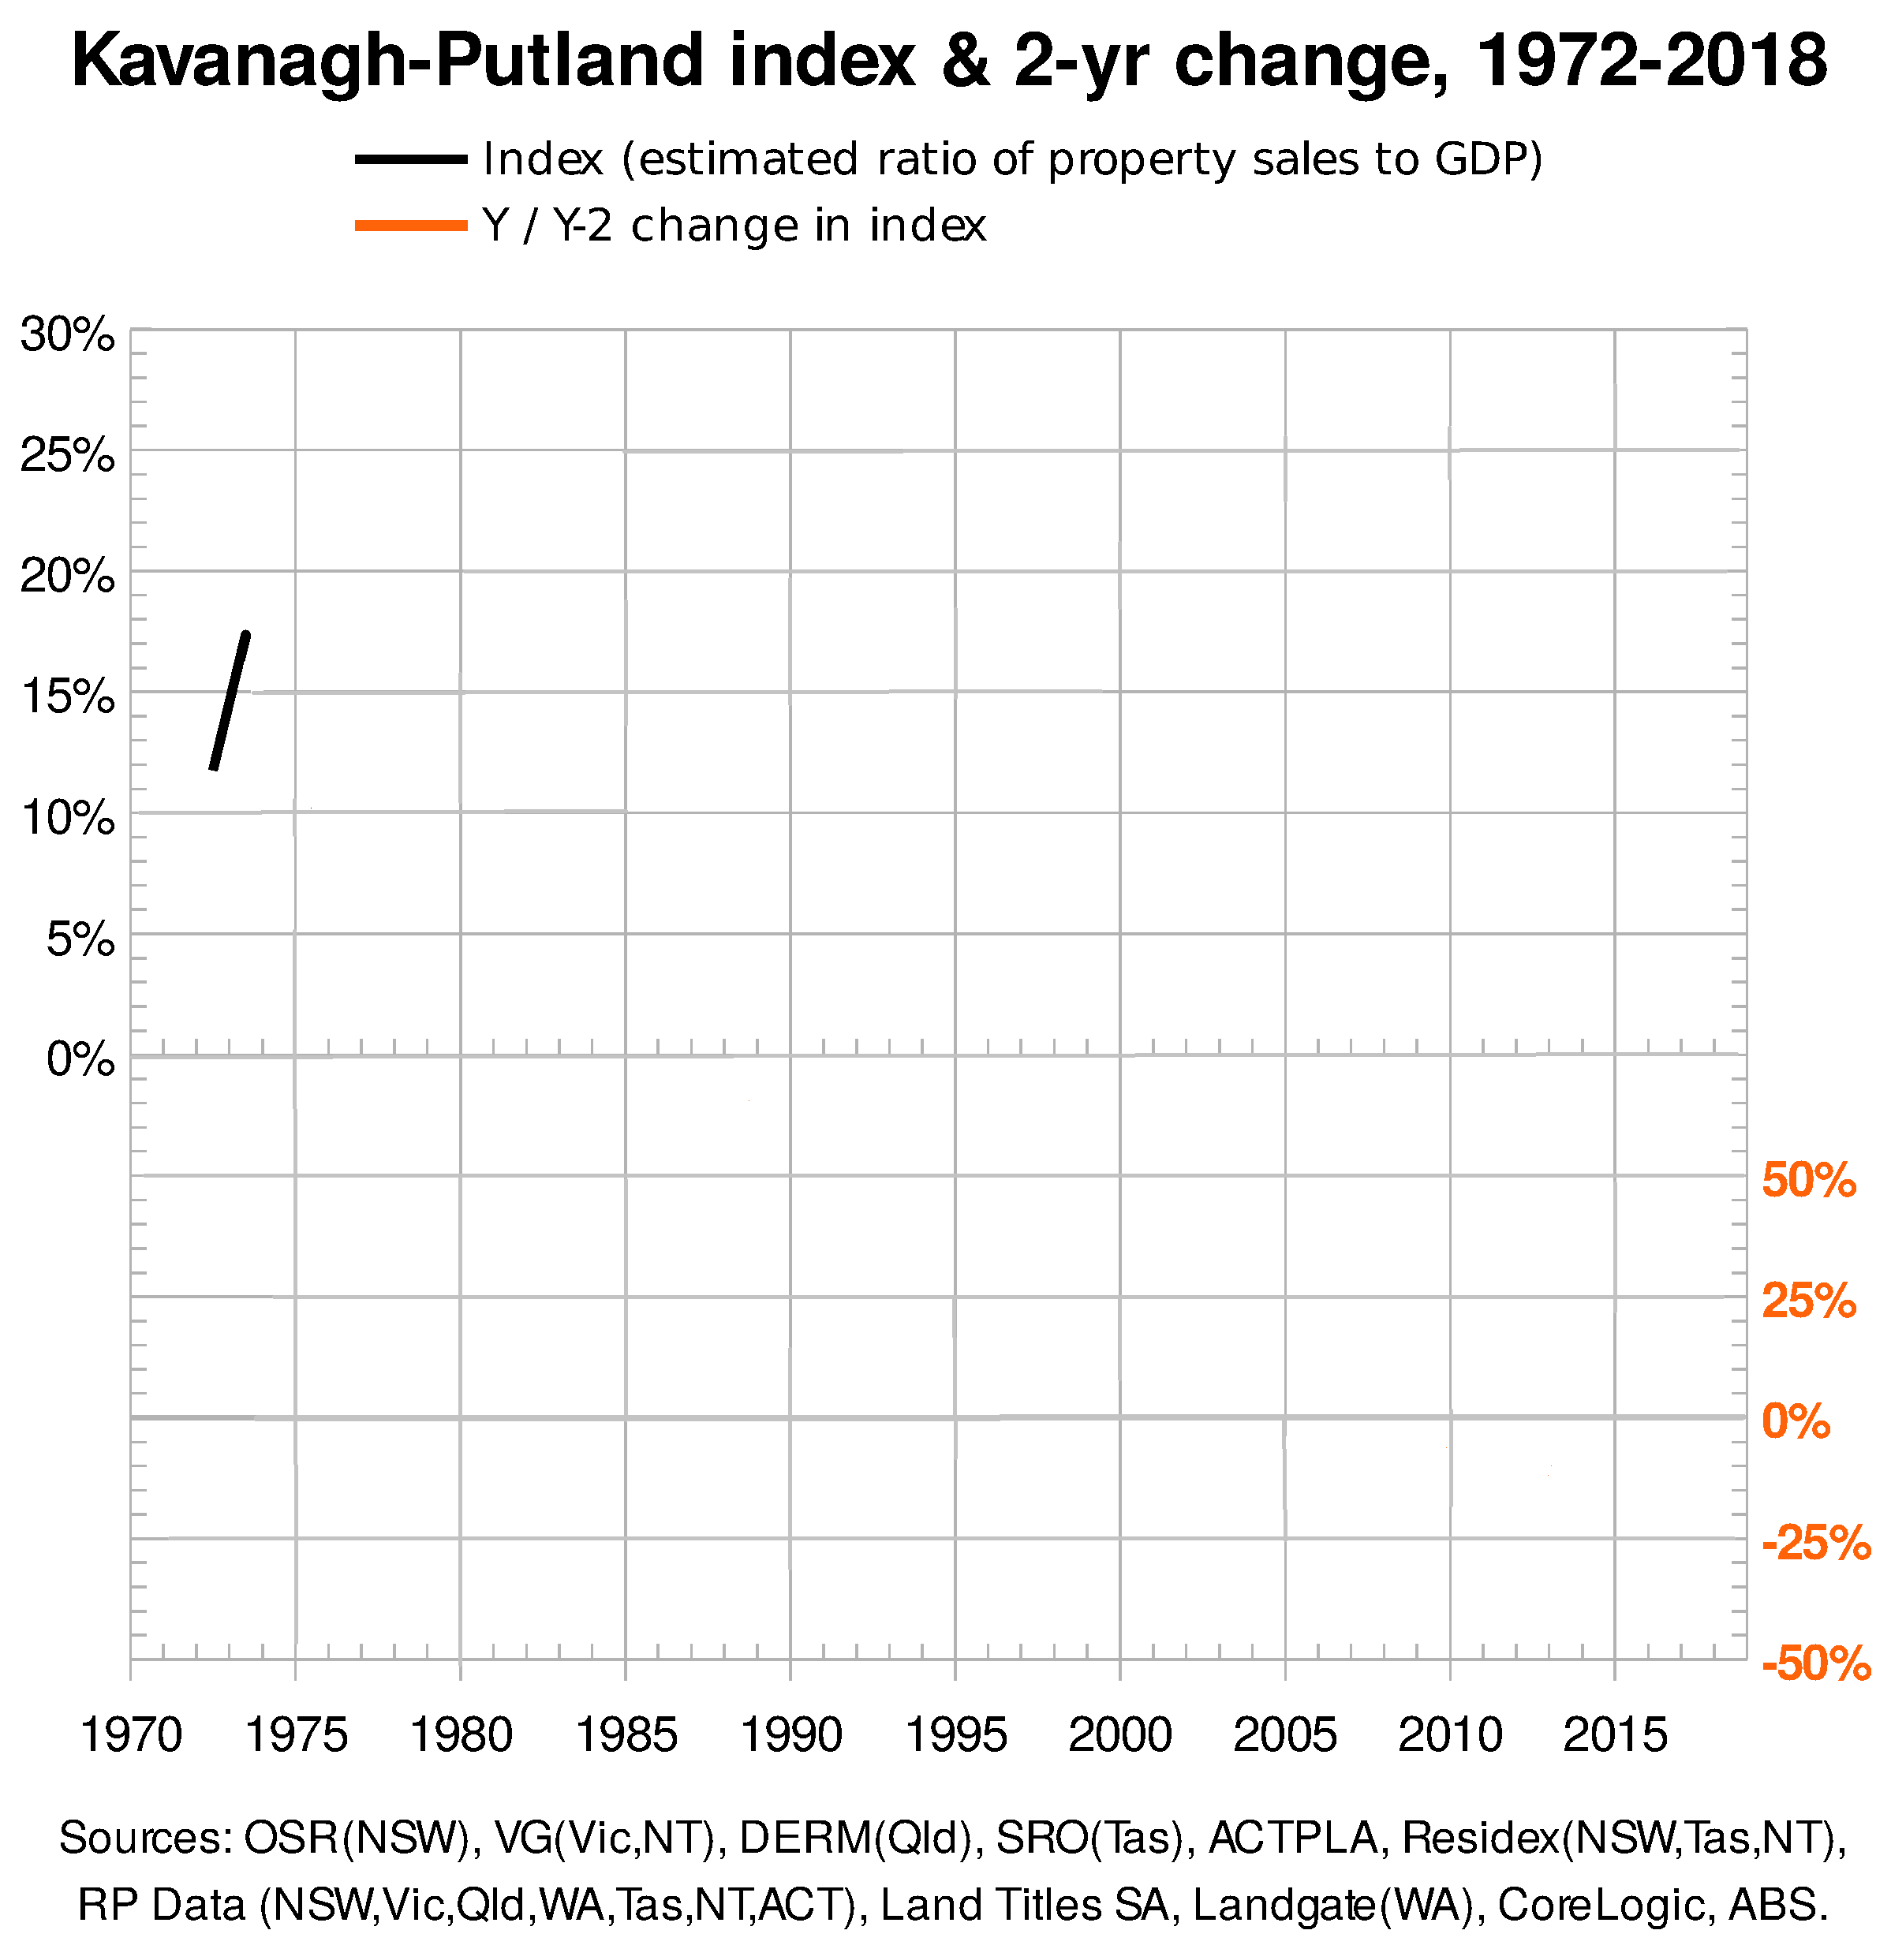
1
The 1972-73 land bubble develops
and peaks (beyond the 15% line).

Slide 3
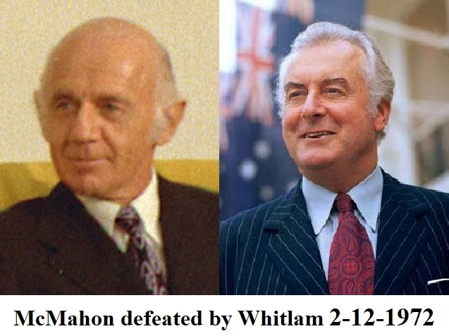
1
The new Whitlam government has come in at the peak of a real estate bubble.

Slide 4
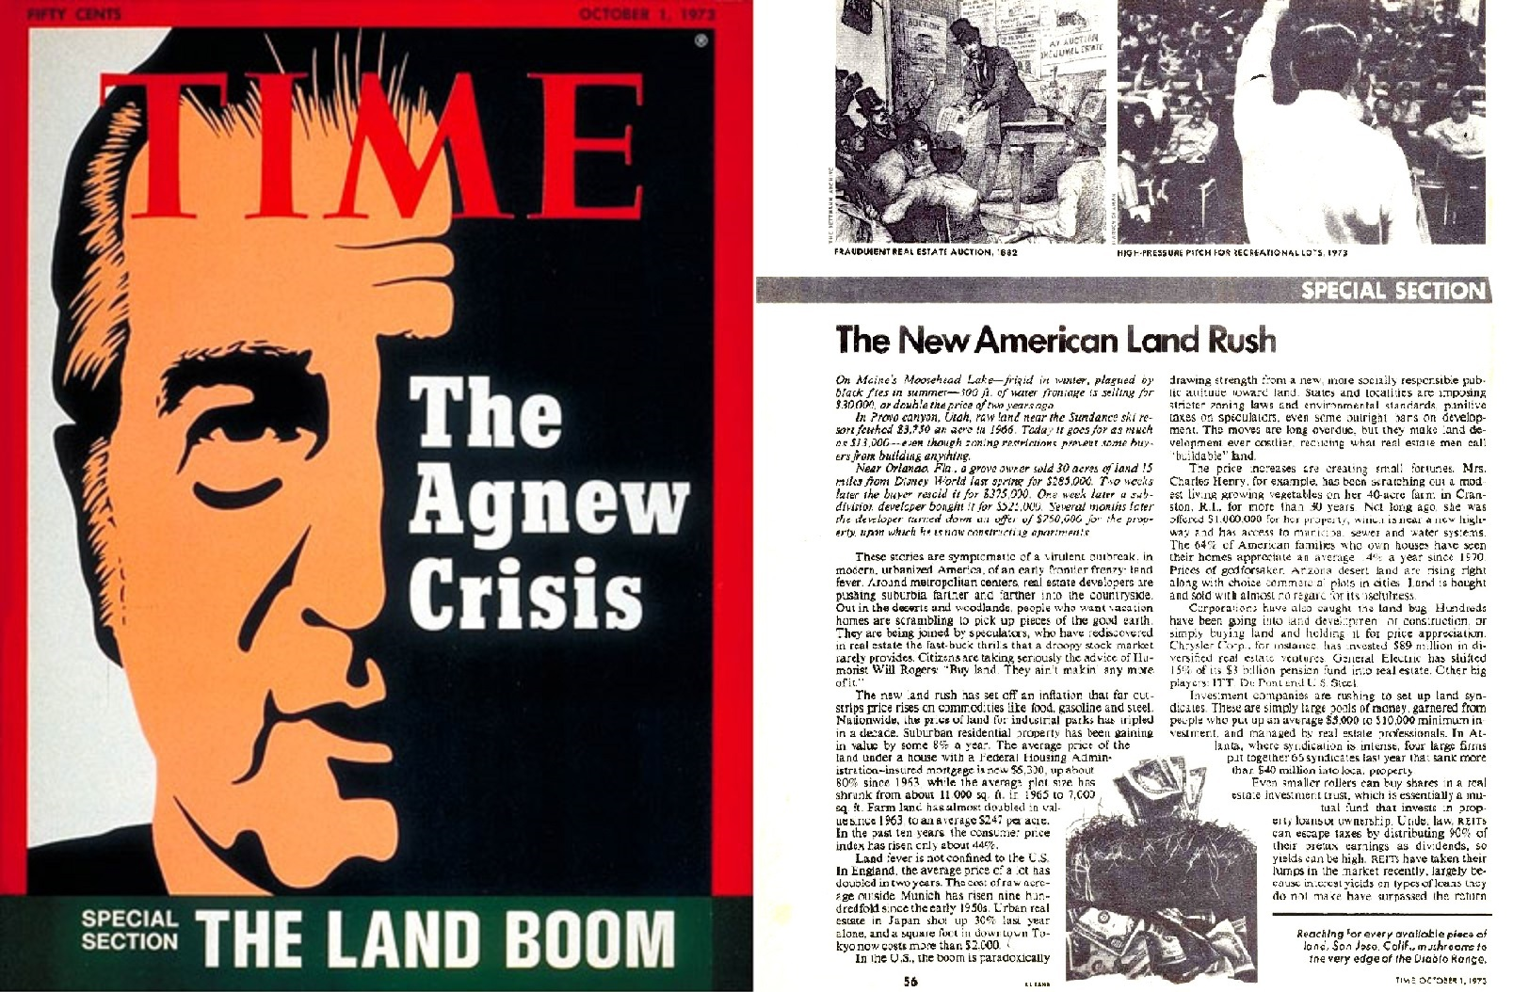
The 1972-73 bubble has developed
across much of the western world.
TIME magazine 1 October, 1973
1

Slide 5
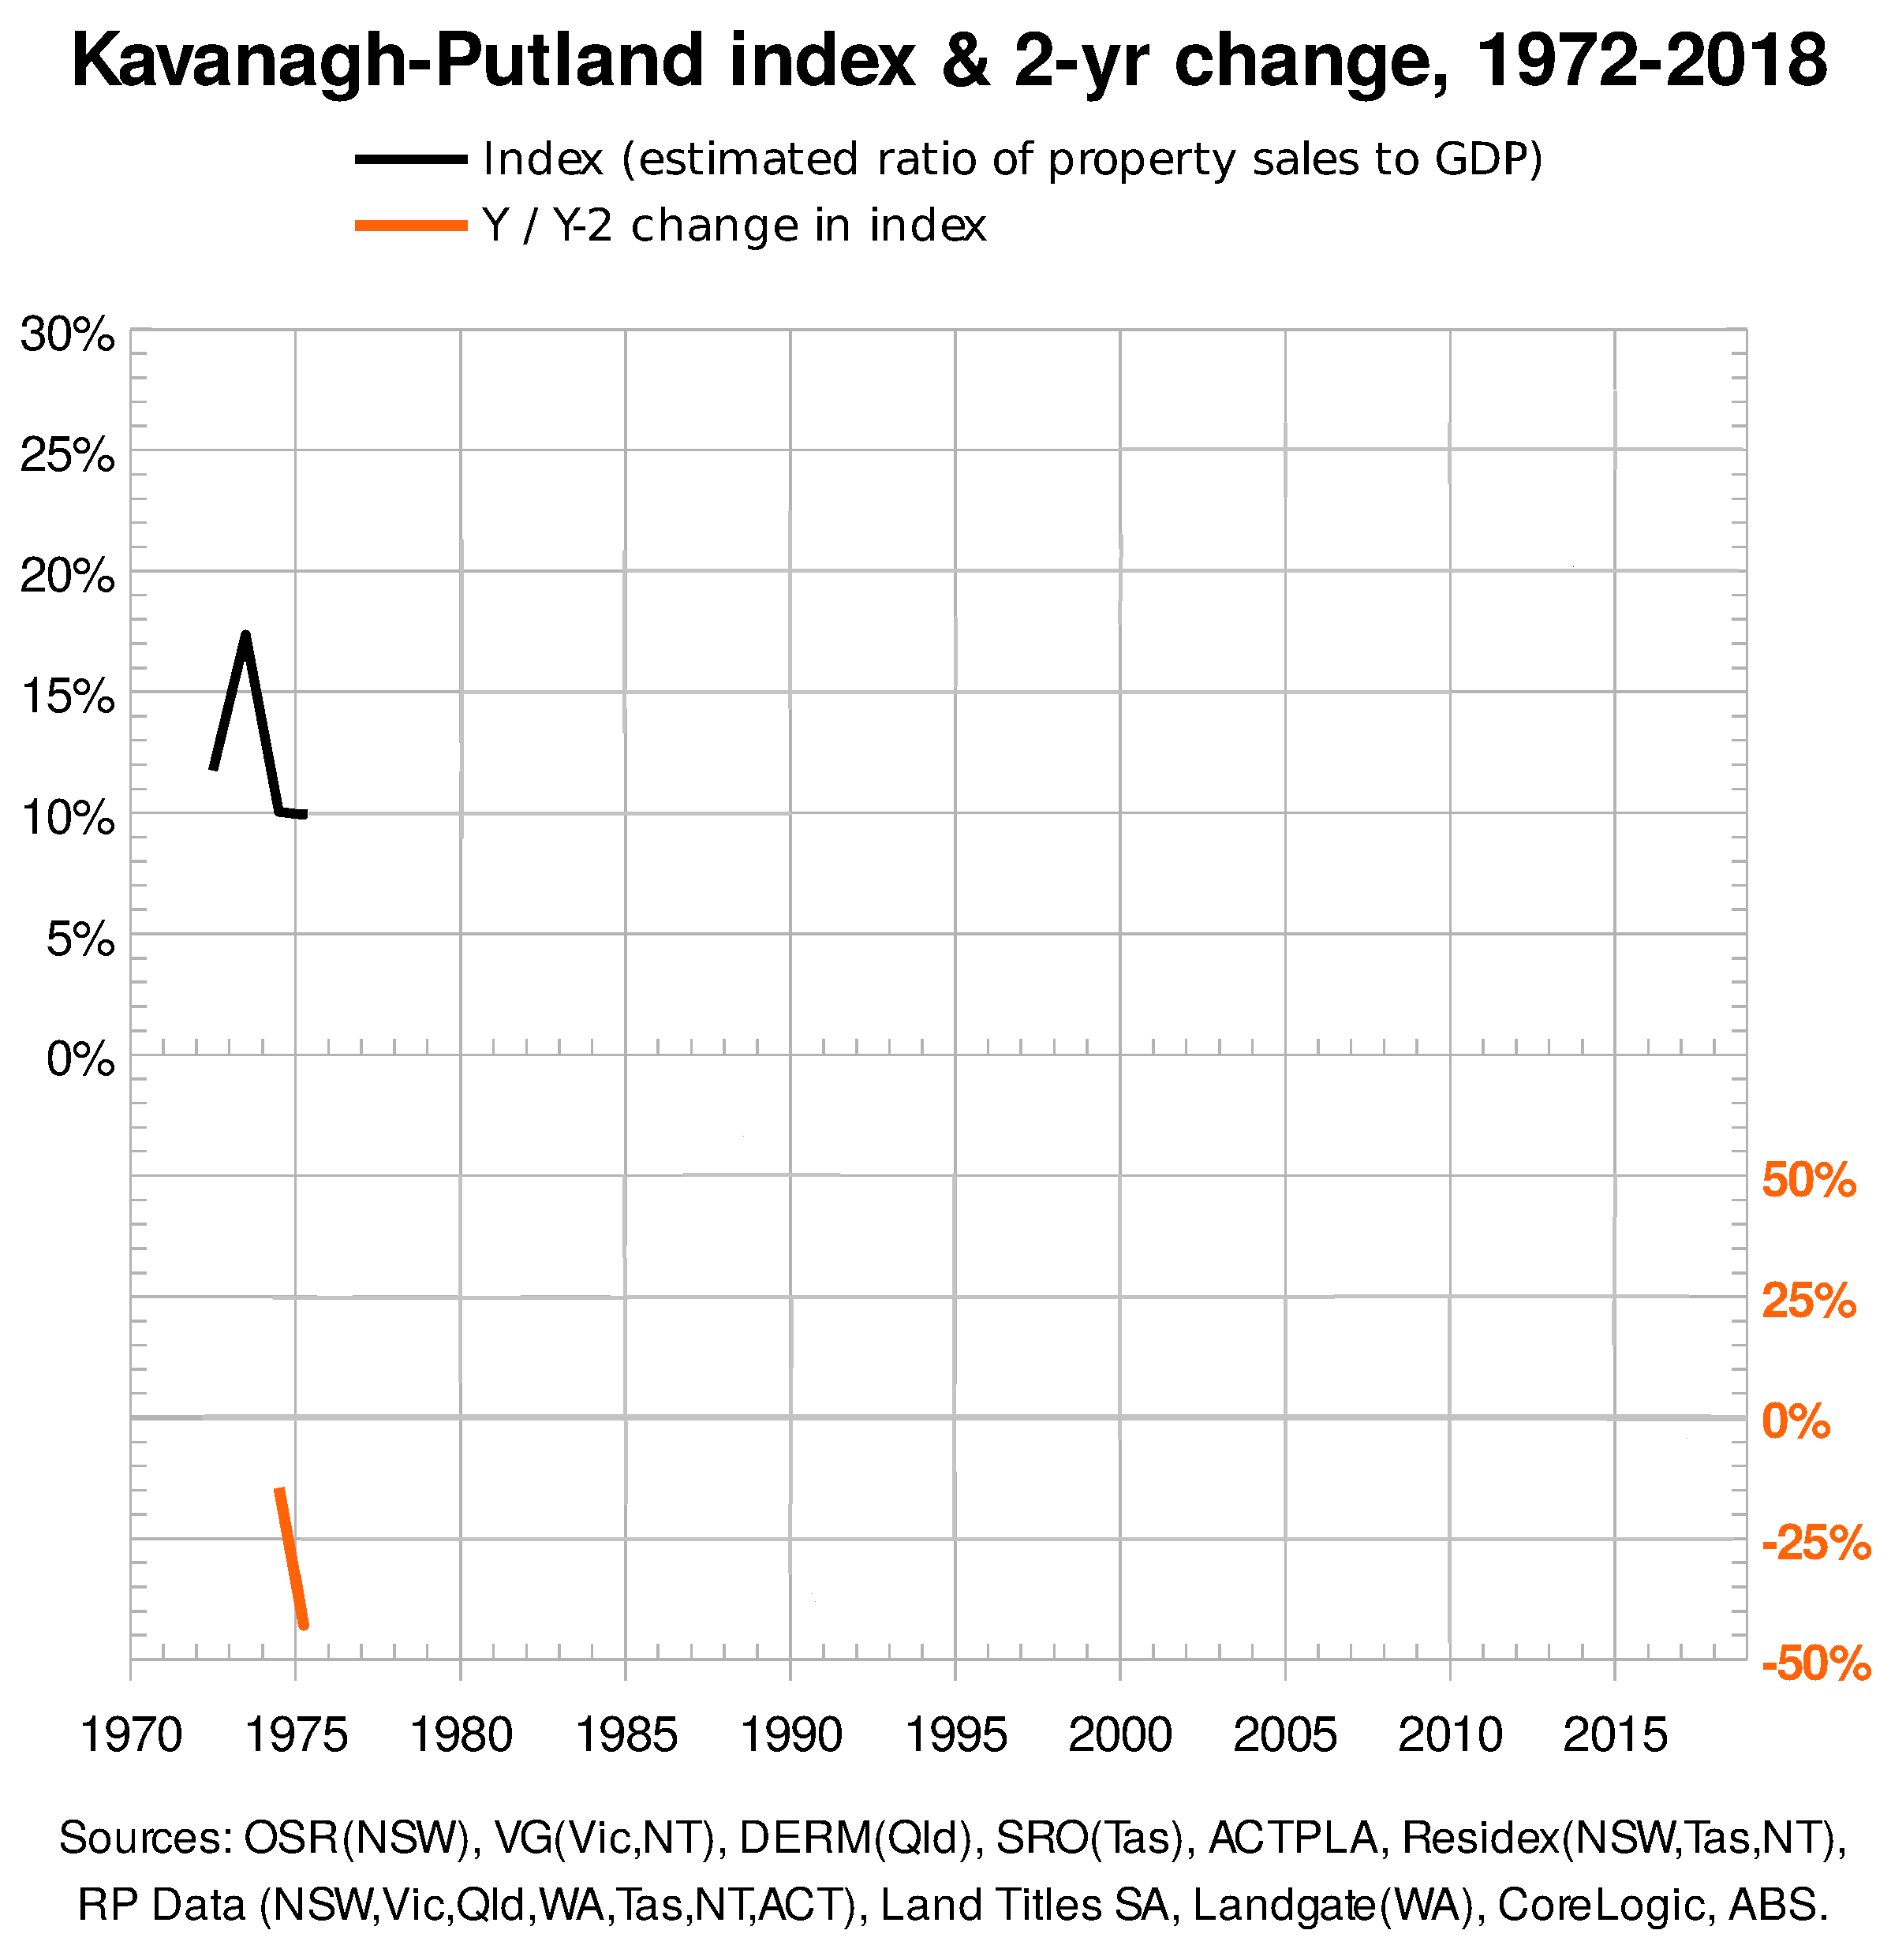
Office-builder, Mainline Corporation,
goes broke in 1974, heralding the
1974-75 recession as the Australian
bubble bursts.
2 year-on-year K-PI
drops more than 25%

Slide 6
1974-75: the land bubble bursts into a recession.
Voters are not happy with Gough Whitlam’s government.
‘Scandals’: Jim Cairns; Rex Connor; the Khemlani affair ……

Slide 7
The 1972-73 land bubble develops and peaks, beyond the 15% line
But could it be that swinging voters are carrying excessive debt, and need a scapegoat when the 1974-5 recession hits?
[The bubble has been all but written out of economic history.]

Slide 8
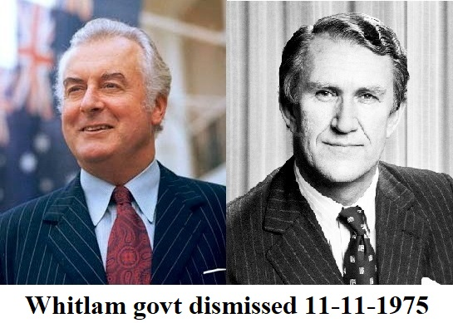
Whitlam is controversially dismissed,
but voters endorse the decision at the
1975 election.

Slide 9
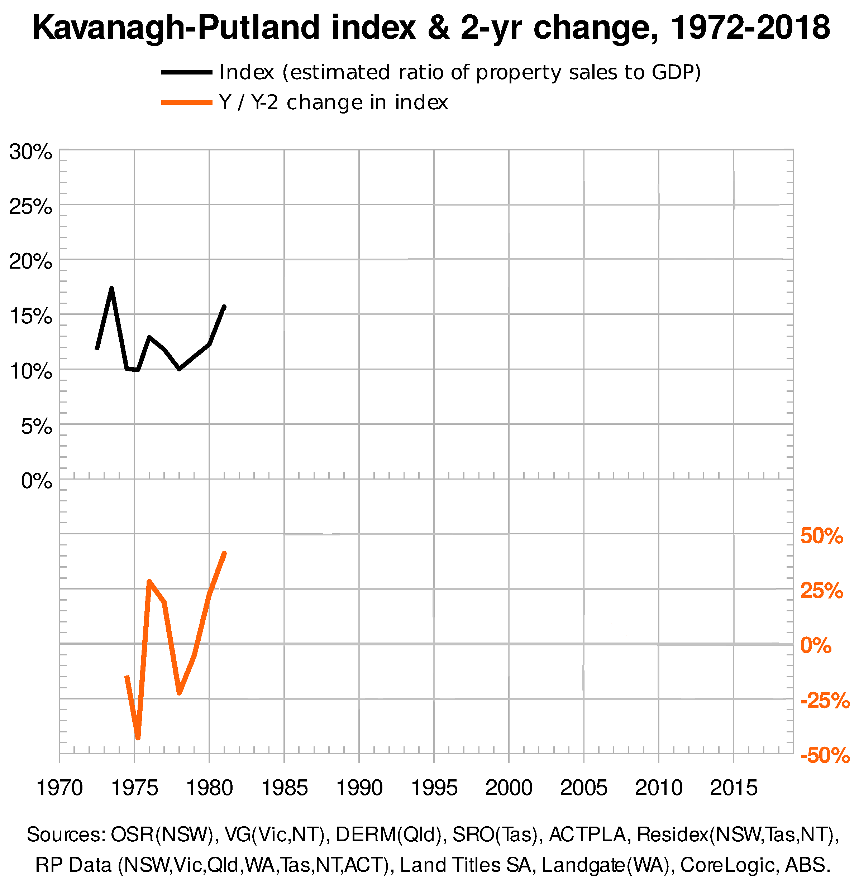
But another land bubble develops under the Fraser government, just peaking beyond the 15% bubble line in 1981 …..

Slide 10
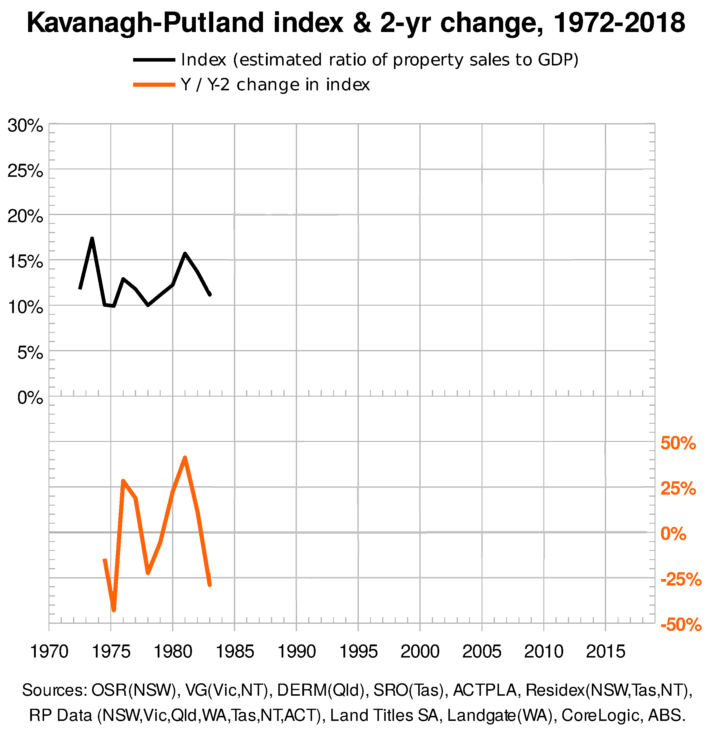
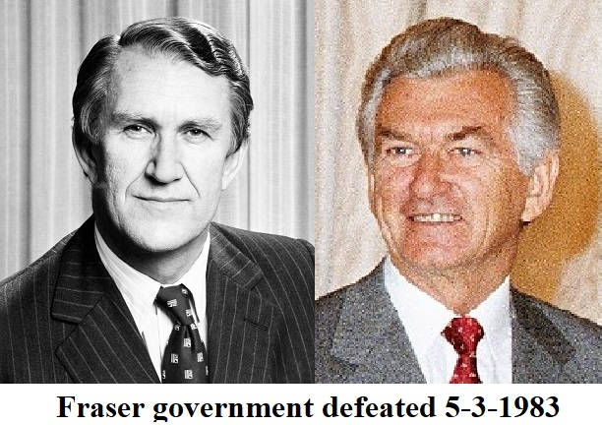
…. and bursting into the 1982-83 recession
> -25%

Slide 11
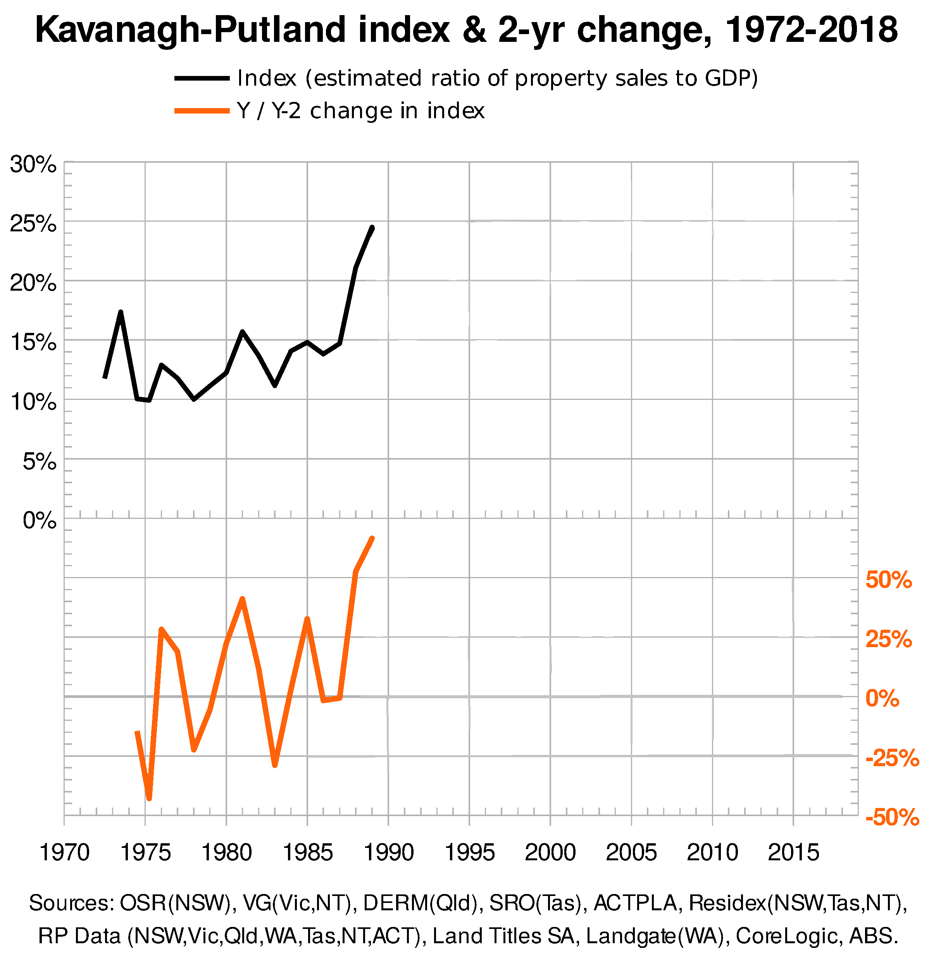
A build-up occurs from 1983 to the enormous land bubble of 1989. This is also experienced in the west and Japan …..
experienced in the west and Japan in 1989.

Slide 12
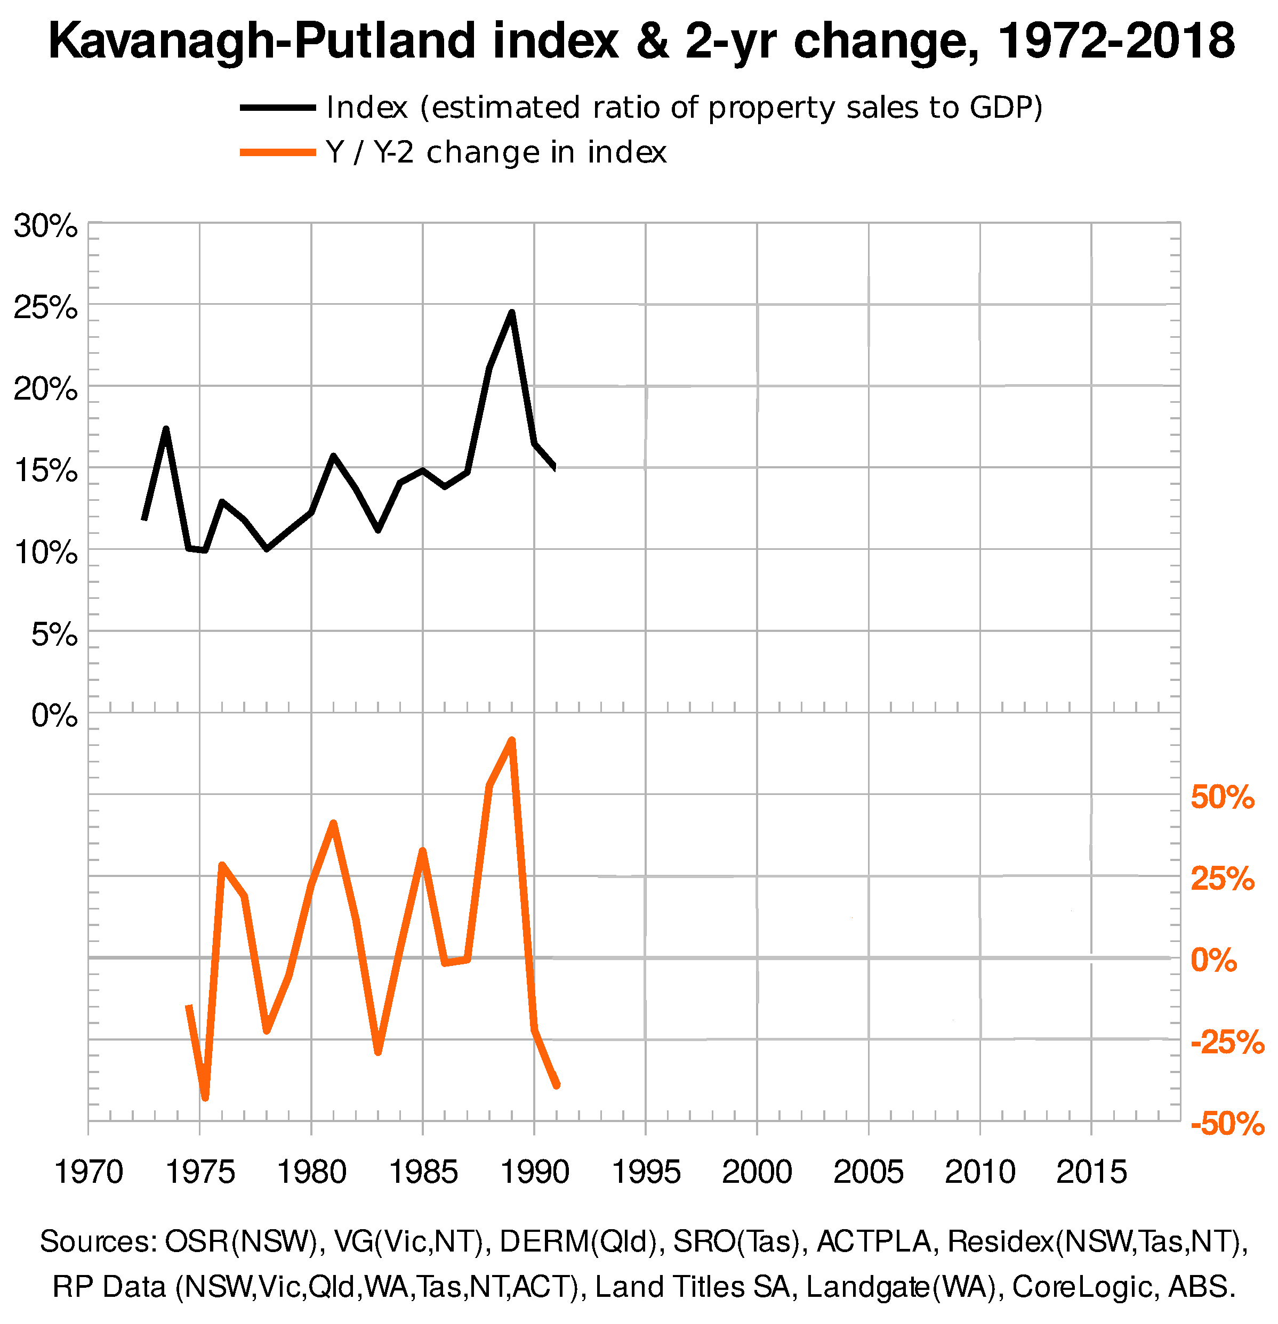
….. and crashes into the 1991 recession (from which Japan has not fully recovered today!)
“The recession we had to have.” – Paul Keating Japan in 1989.
Below -25% 2-year change

Slide 13
In Melbourne, there is one million square metres of vacant new office accommodation (i.e. 20 ‘Melbourne Cricket Grounds’).
Deals are made, offering free office fit-outs and up to ten years’ rent-free terms, to attract tenants – but let-ups are slow.
experienced in the west and Japan in 1989.

Slide 14
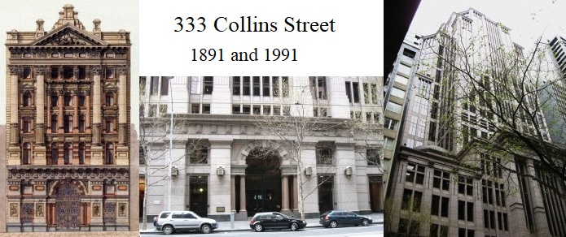
The development of 333 Collins Street, Melbourne,
in which the State Savings Bank of Victoria’s investment arm Tricontinental is involved, sends the SSB broke - and the State Government Insurance Corporation of South Australia, and the State Bank of South Australia.
The Commercial Bank of Australia built at the same address 100 years before, closed its doors in 1893 when the 1890s depression hit.
experienced in the west and Japan in 1989.

Slide 15
The 1991 recession cripples
the governments of South Australia and Victoria.
The Labor governments of Victoria and South Australia are defeated in massive landslides at the elections of 1992 and 1993, respectively.

Slide 16
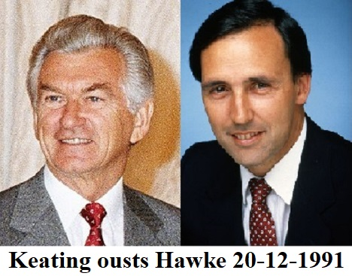
1991: Paul Keating deposes his leader

Slide 17
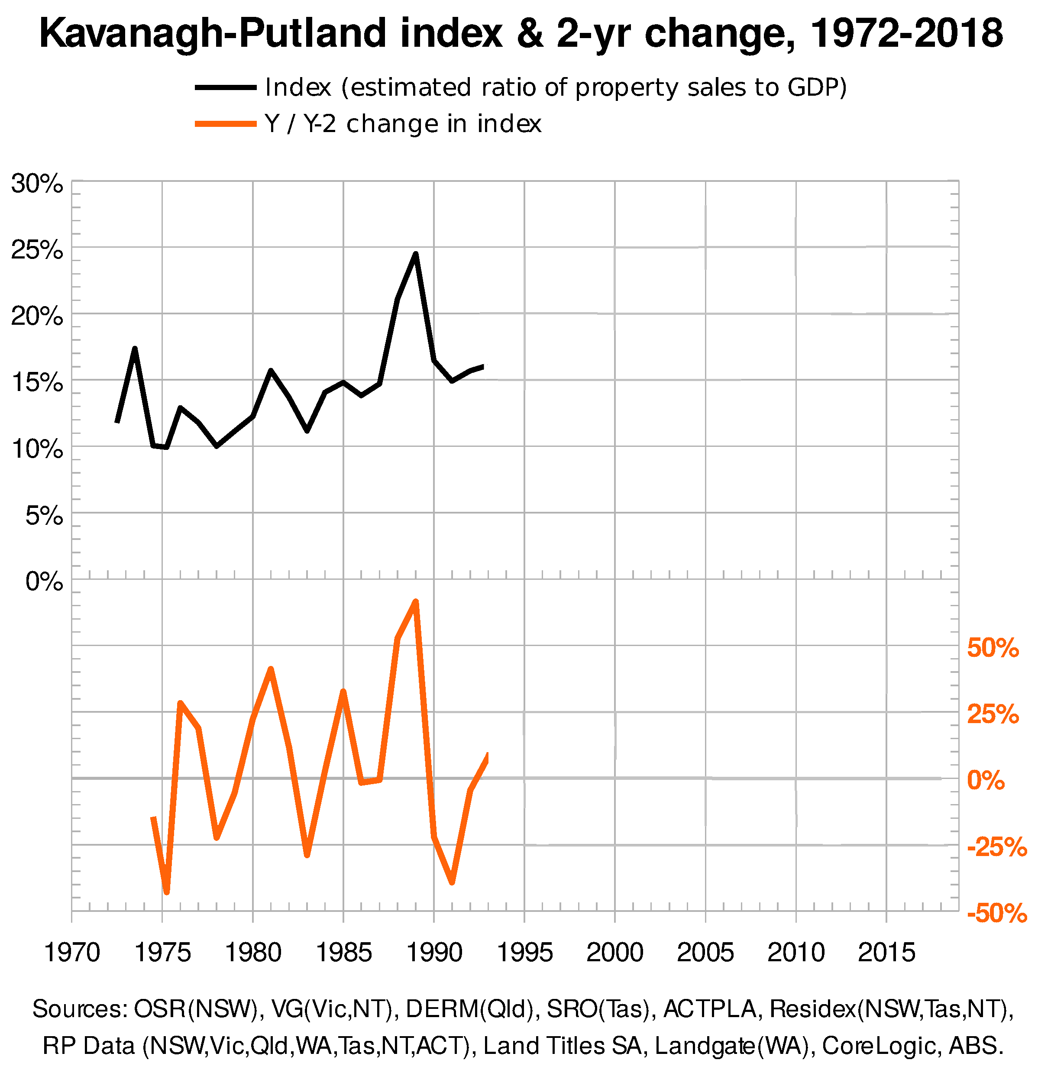
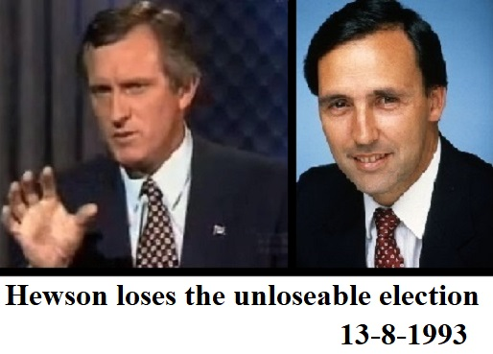
In 1993, Keating does the impossible: he holds on after a recession.
“GST on a birthday cake, John?”

Slide 18
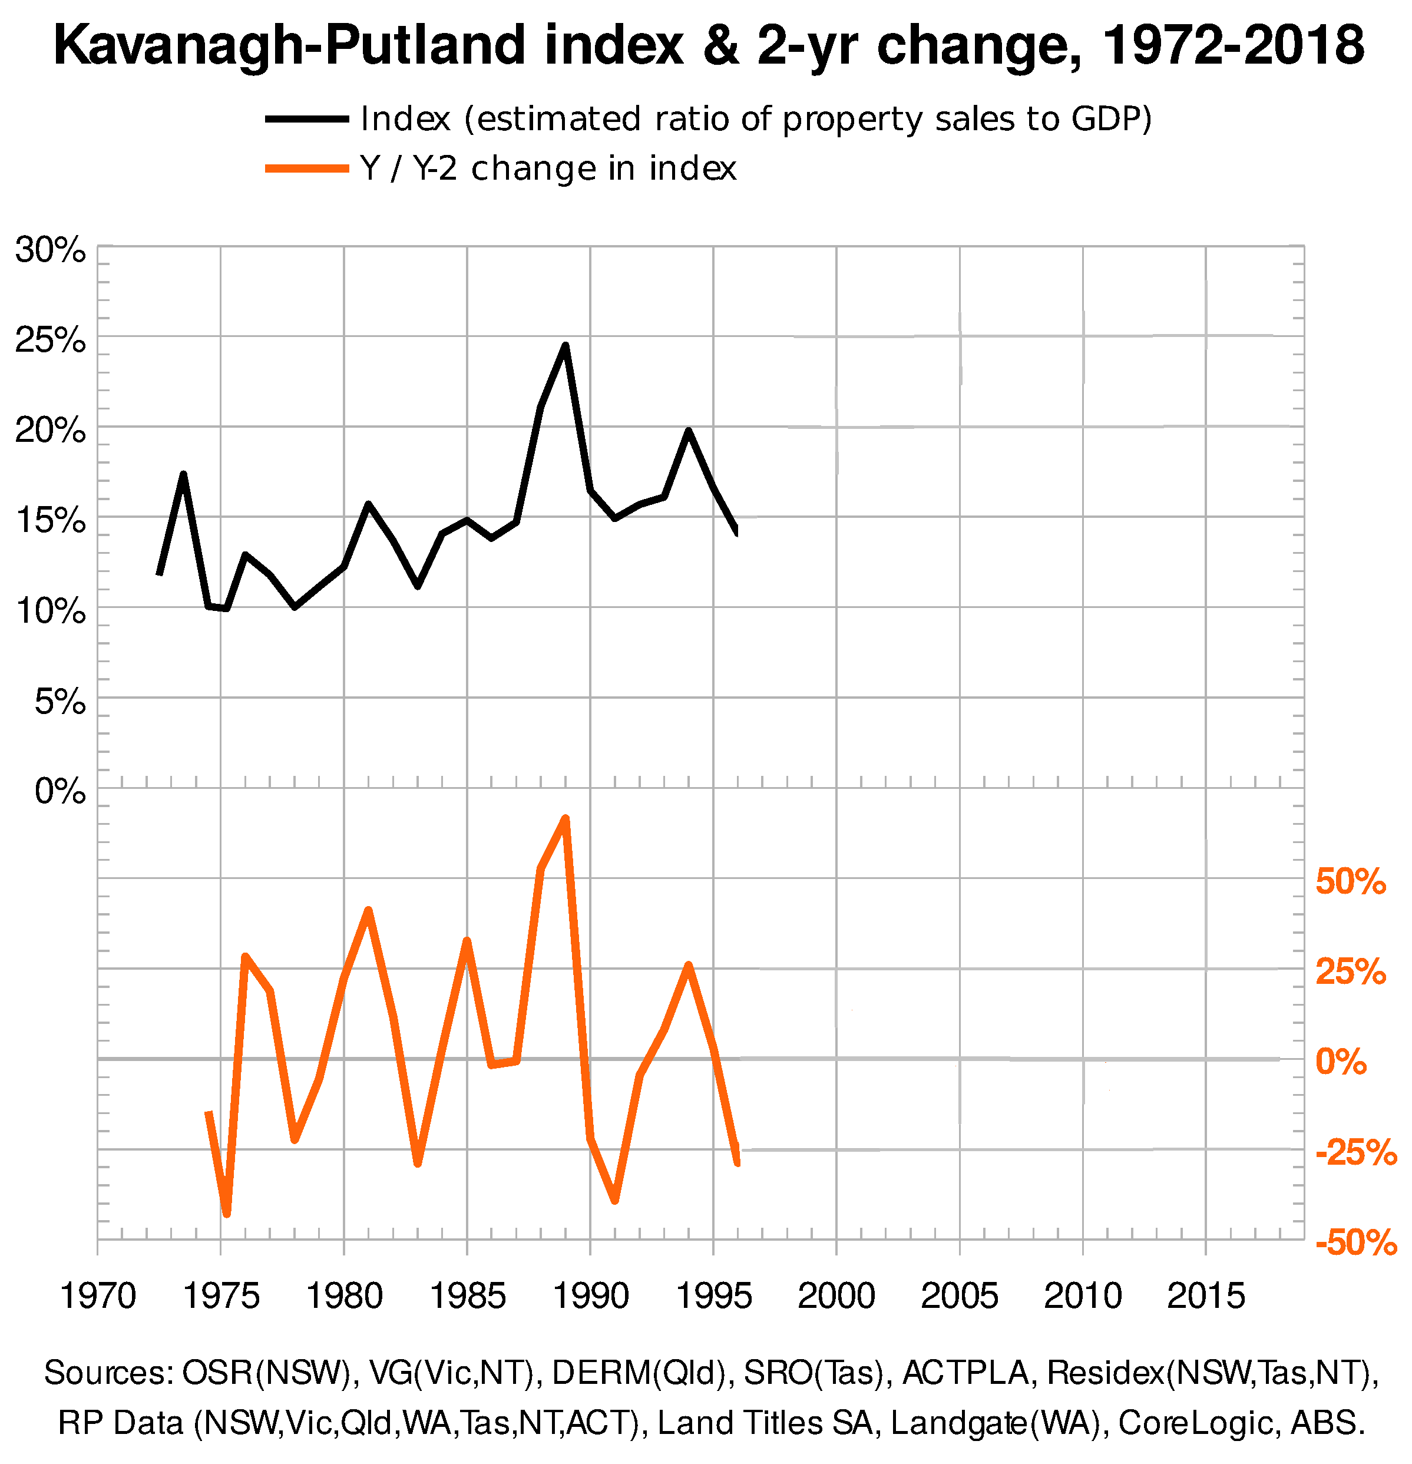
Premier of Queensland, Wayne Goss, is considered the most popular and able politician in Australia in the early 1990s.
In 1994, as banks are clearing their big commercial and industrial sales (as mortgagee-in-possession), Queensland shares a real estate boom of its own with South-East Asia.
There is no boom in the other states, so on this occasion 1994 is NOT an Australia-wide bubble.

Slide 19
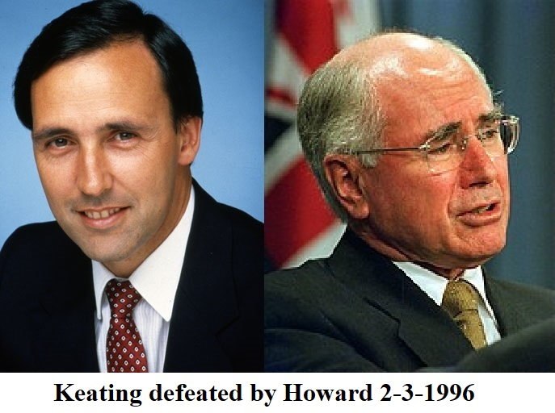
Nevertheless, in the 1996 election Australians decide they’ve seen enough of Paul Keating ….. and as the Queensland boom tanks in 1996 too, along with South-East Asia, Queenslanders unceremoniously dump their recently-popular premier.

Slide 20
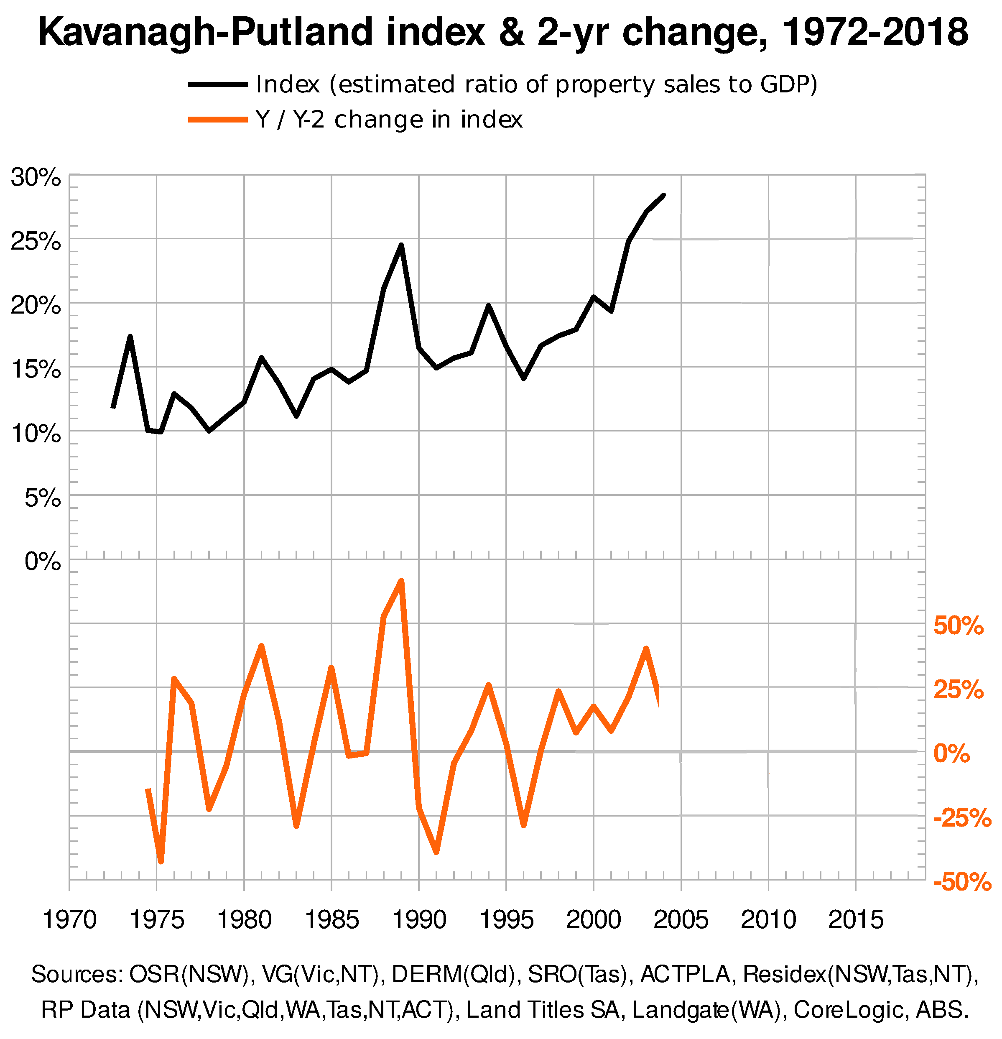
But the tax regime is insistent, and from 1996 Australians receive its message again: there is much more to be had in real estate investment than in trying to earn an income.
So, the real estate market shoots up to a record peak in 2004.
The trend shows real estate sales to be doing much better than productivity
Any time real estate prices look to falter, the Howard government feeds them by increasing the grants to home buyers.
That’s what a politician of any stripe does in Australia.

Slide 21
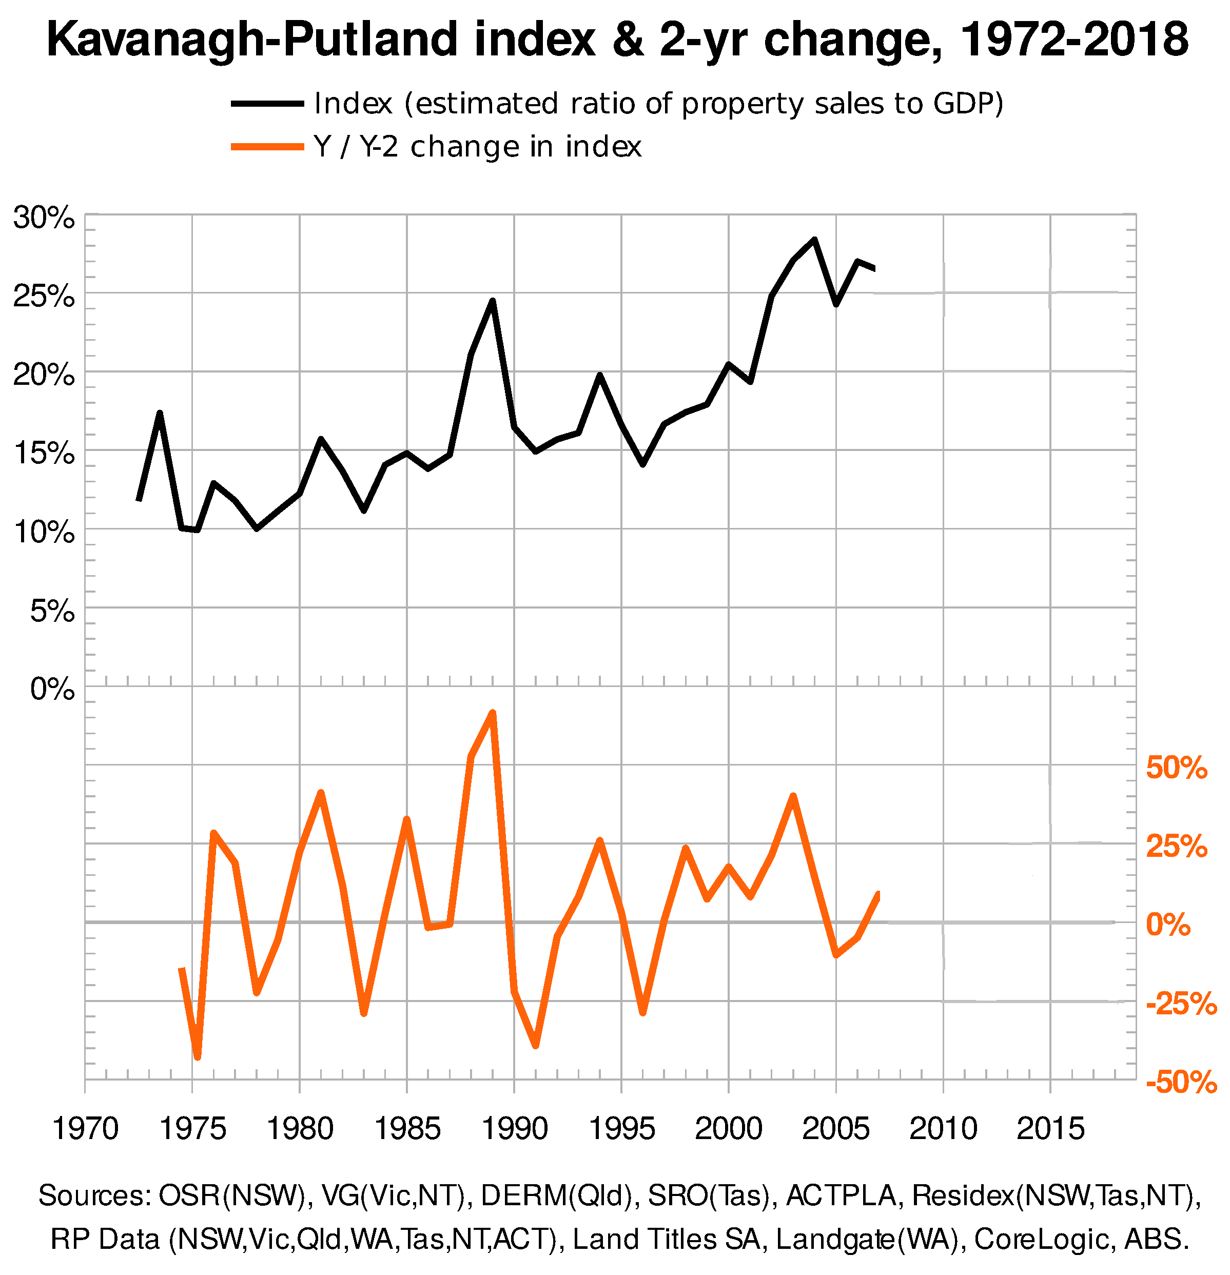
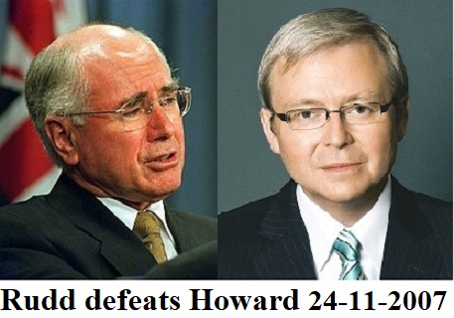
The bubble is a bit shaky by 2007, and voters have had enough of John Howard.
So, introducing Kevin Rudd ….

Slide 22
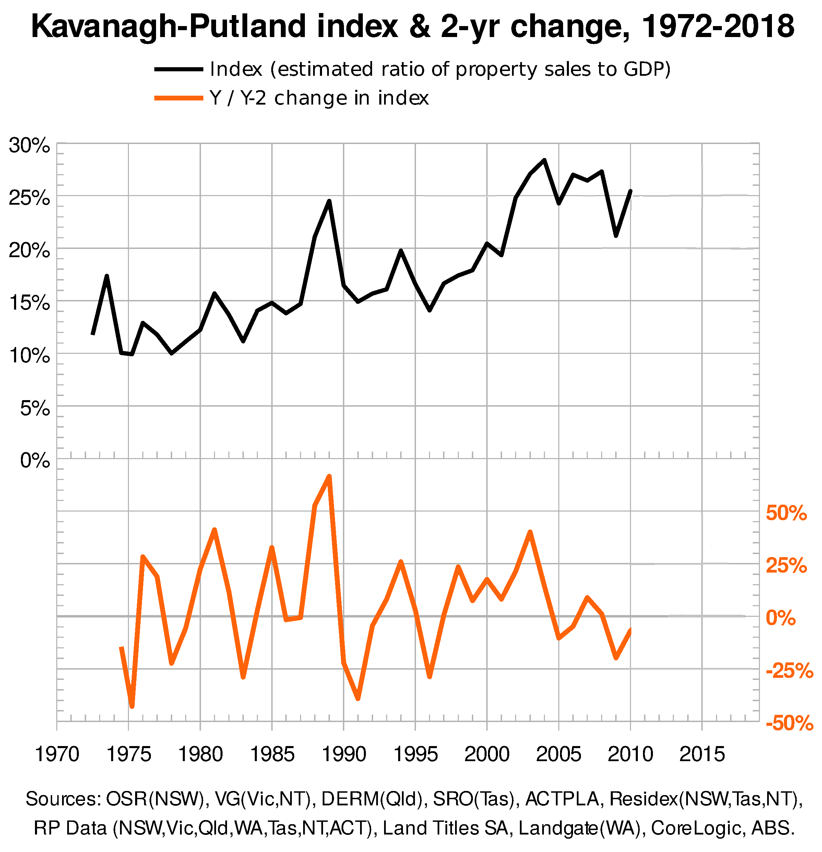
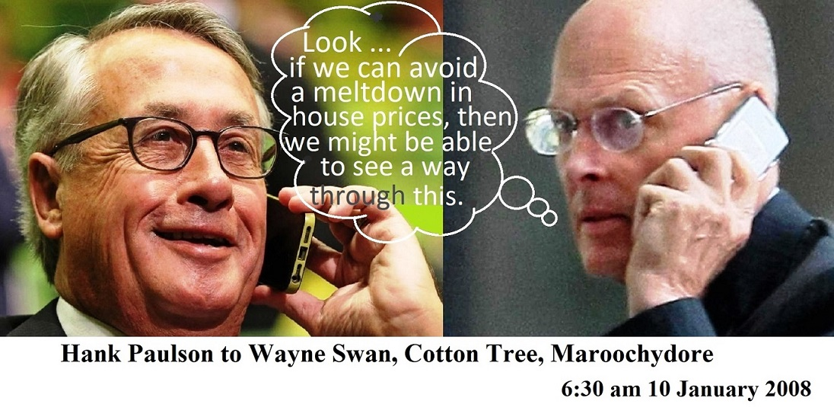
Though the market is shaky, the K-P Index continues to dwarf the 15% “bubble” line.
America collapses financially in 2007-08, and Kevin Rudd’s Treasurer, Wayne Swan, receives a call from US Treasury Secretary, Hank Paulson:

Slide 23
Paulson isn’t able to keep the US
bubble from deflating, but from 2008 the Rudd-Swan government frantically spends more than $50 billion—in cash grants; pink batts; on new educational buildings—to keep the bubble inflated.
Two years of pumping succeeds in keeping the real estate market inflated and ‘up there’.
The wider economy languishes.

Slide 24
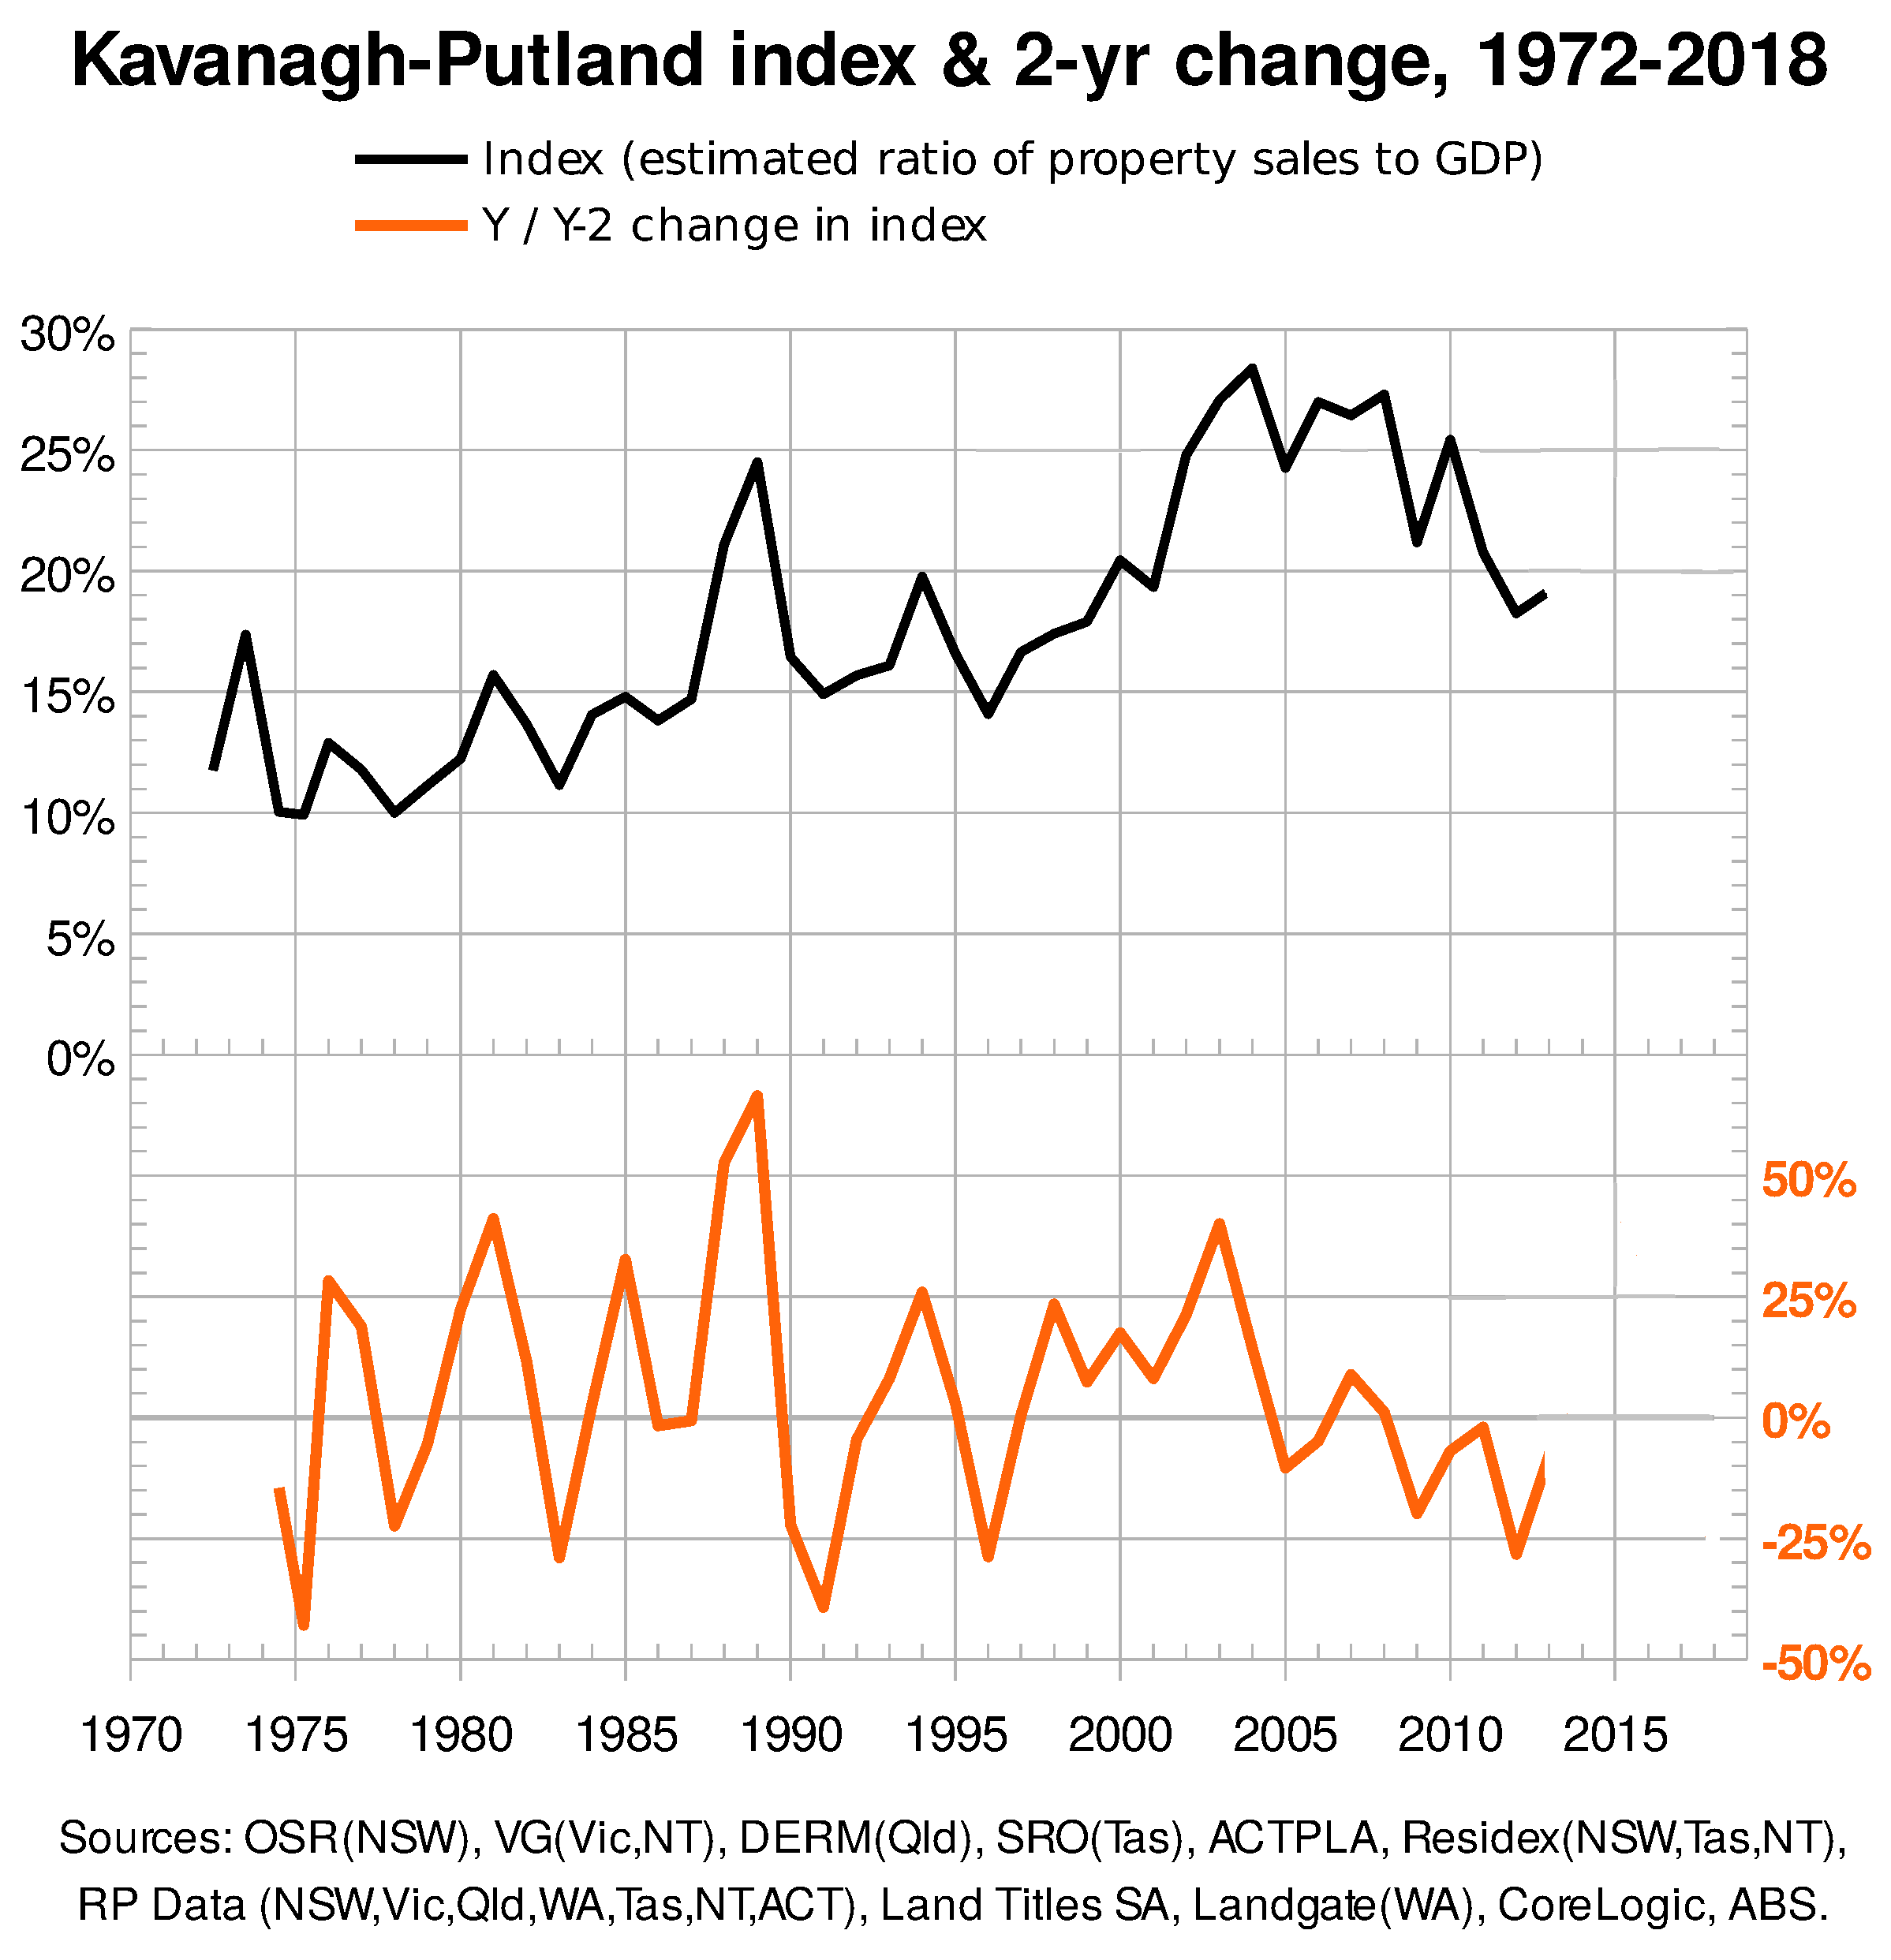
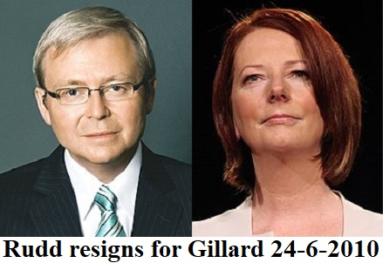
But people feel the difficult times,
and Kevin Rudd has become unpopular
amongst his Labor Party colleagues.
So, under pressure in 2010, Rudd
resigns in favour of Julia Gillard.

Slide 25
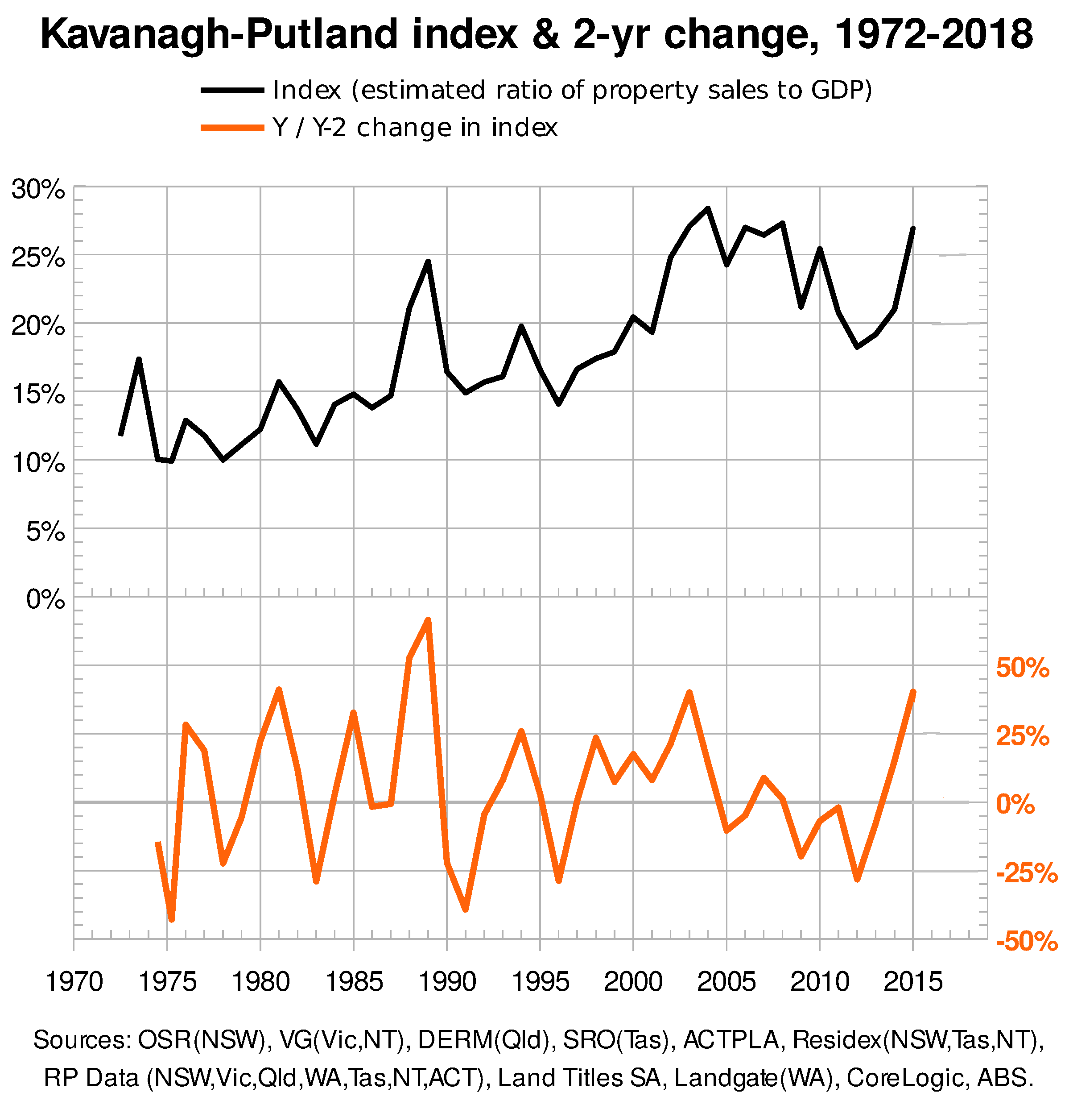
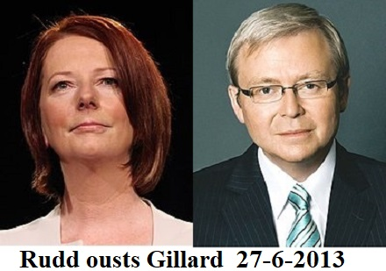
But Gillard is only able to form a minority government at the 2010 election, and although she performs well under difficult circumstances, Labor decides in 2013 she can’t win the next election. It reinstates Kevin Rudd as leader of the party.

Slide 26
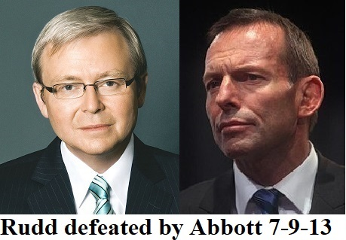
But it’s to no avail. Tony Abbott wins the 2013 election as the market spikes upwards to a new peak in 2015. This is some extended
bubble beyond the 15% bubble mark!

Slide 27
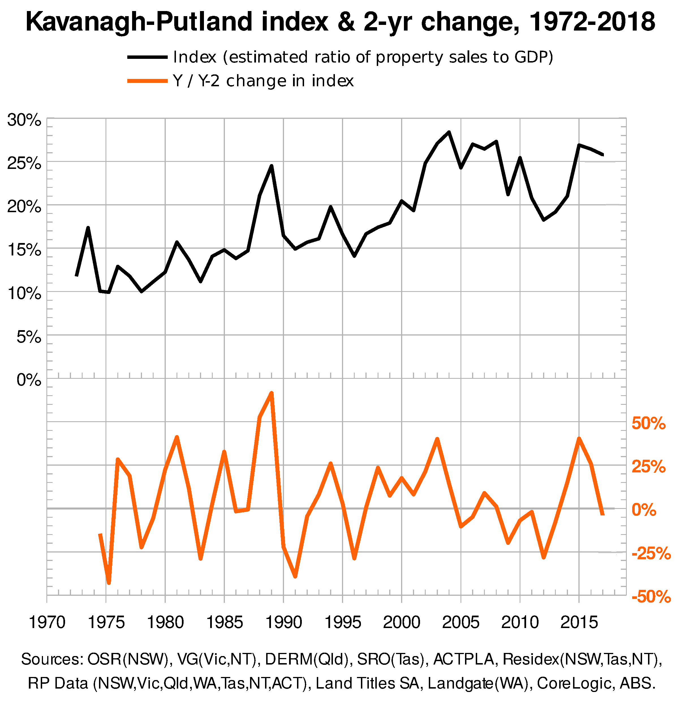
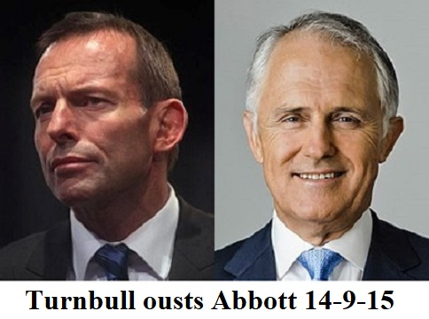
But the bubble is the only thing winning as wages stagnate.
Abbott’s 2014 budget is disastrous, so Malcolm Turnbull makes his play.

Slide 28
From 2015 to 2017, the real estate market looks to give way to increasing productivity, but the piper must first be paid - for the greatest real estate bubble in Australia’s history.
Australian levels of private debt are the world’s highest.
A passing parade of Australian leaders looks evermore irrelevant. Unable to even mention the bubble, they have lost control of the economy.

Slide 29
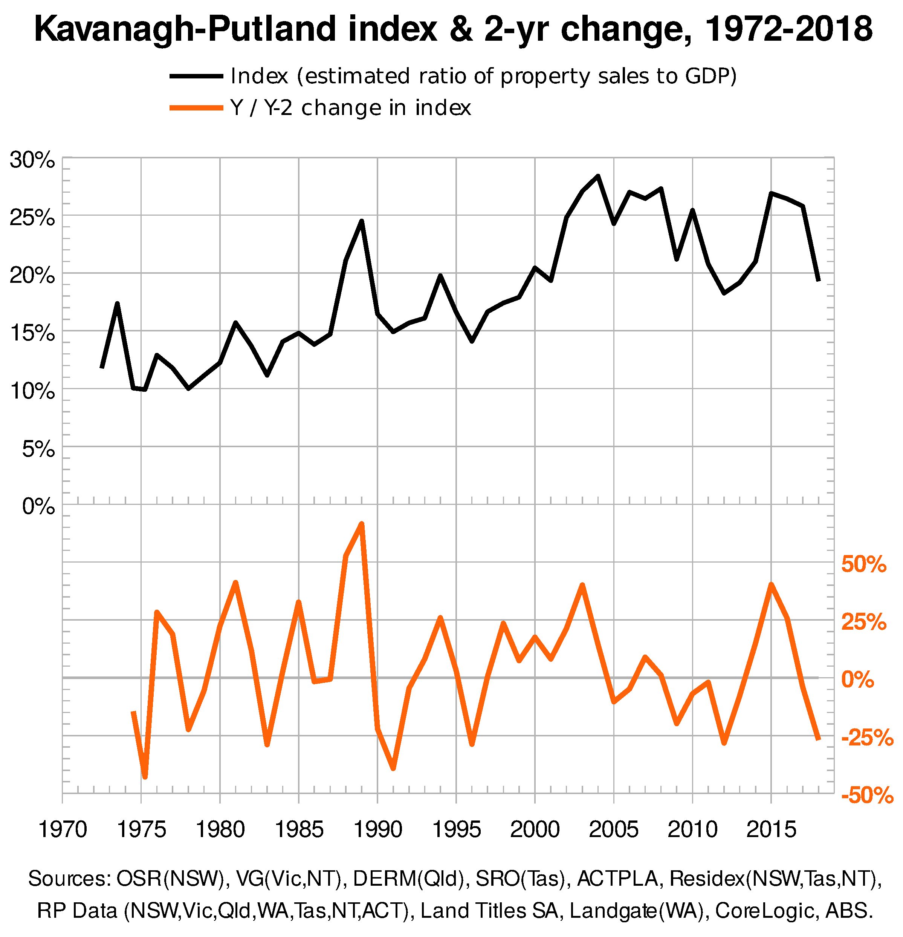
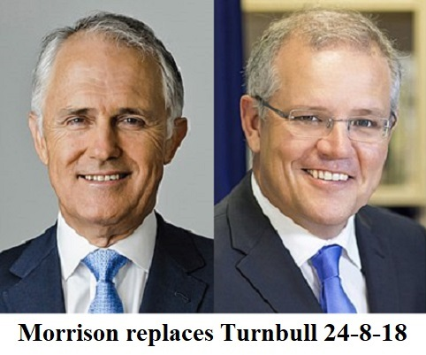
2018 - and another leader!
When the 2-yearly change in the index declines by more than 25%, this is usually indicative of a recession within 2 years. That magical number was exceeded in 2018, so we should have a recession before June 2020. more than 25% - and it did this during 2
It’s beyond time, surely, for our leaders to see that real estate bubbles play socio-economic havoc with the economy?

